Slide 1
Overview
Pipelining is widely used in modern processors.
Pipelining improves system performance in terms of throughput.
Pipelined organization requires sophisticated compilation techniques.

Slide 2
Basic Concepts

Slide 3
Making the Execution of Programs Faster
Use faster circuit technology to build the processor and the main memory.
Arrange the hardware so that more than one operation can be performed at the same time.
In the latter way, the number of operations performed per second is increased even though the elapsed time needed to perform any one operation is not changed.

Slide 4
Traditional Pipeline Concept
Laundry Example
Ann, Brian, Cathy, Dave
each have one load of clothes
to wash, dry, and fold
Washer takes 30 minutes
Dryer takes 40 minutes
“Folder” takes 20 minutes
A
B
C
D

Slide 5
Traditional Pipeline Concept
6 PM
7
8
9
10
11
Midnight
Time
30
40
20
30
40
20
30
40
20
30
40
20
Sequential laundry takes 6 hours for 4 loads
If they learned pipelining, how long would laundry take?
A
B
C
D

Slide 6
Traditional Pipeline Concept
6 PM
7
8
9
10
11
Midnight
T
a
s
k
O
r
d
e
r
Time
30
40
40
40
40
20
A
Pipelined laundry takes 3.5 hours for 4 loads
B
C
D

Slide 7
Traditional Pipeline Concept
6 PM
7
8
9
Pipelining doesn’t help latency of single task, it helps throughput of entire workload
Pipeline rate limited by slowest pipeline stage
Multiple tasks operating simultaneously using different resources
Potential speedup = Number pipe stages
Unbalanced lengths of pipe stages reduces speedup
Time to “fill” pipeline and time to “drain” it reduces speedup
Stall for Dependences
Time
T
a
s
k
O
r
d
e
r
30
40
40
40
40
20
A
B
C
D

Slide 8
Use the Idea of Pipelining in a Computer
Fetch + Execution
T
ime
I
1
I
2
I
3
T
ime
Clock cycle
1
2
3
4
F
1
E
1
F
2
E
2
F
3
E
3
Instruction
(a) Sequential execution
I
1
F
1
E
1
I
2
F
2
E
2
Interstage buffer
B1
I
3
F
3
E
3
Instruction
Ex
ecution
fetch
unit
(c) Pipelined execution
unit
(b) Hardware organization
Figure 8.1. Basic idea of instruction pipelining.

Slide 9
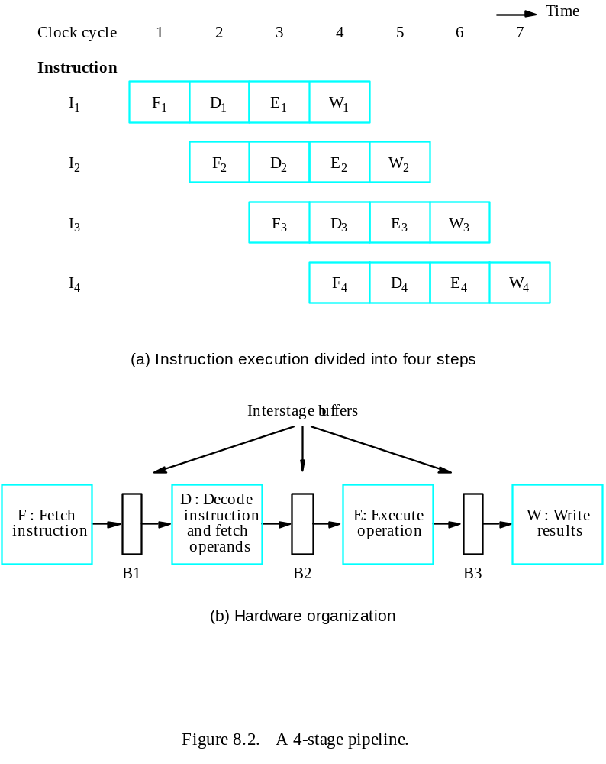
Use the Idea of Pipelining in a Computer
Fetch + Decode
+ Execution + Write
Textbook page: 457

Slide 10
Role of Cache Memory
Each pipeline stage is expected to complete in one clock cycle.
The clock period should be long enough to let the slowest pipeline stage to complete.
Faster stages can only wait for the slowest one to complete.
Since main memory is very slow compared to the execution, if each instruction needs to be fetched from main memory, pipeline is almost useless.
Fortunately, we have cache.

Slide 11
Pipeline Performance
The potential increase in performance resulting from pipelining is proportional to the number of pipeline stages.
However, this increase would be achieved only if all pipeline stages require the same time to complete, and there is no interruption throughout program execution.
Unfortunately, this is not true.

Slide 12
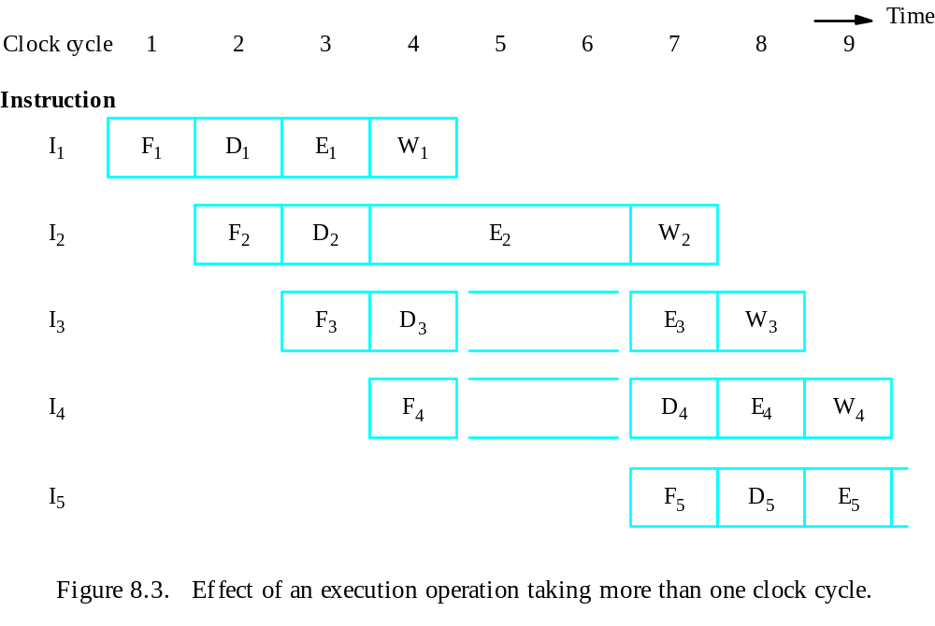
Pipeline Performance

Slide 13
Pipeline Performance
The previous pipeline is said to have been stalled for two clock cycles.
Any condition that causes a pipeline to stall is called a hazard.
Data hazard – any condition in which either the source or the destination operands of an instruction are not available at the time expected in the pipeline. So some operation has to be delayed, and the pipeline stalls.
Instruction (control) hazard – a delay in the availability of an instruction causes the pipeline to stall.
Structural hazard – the situation when two instructions require the use of a given hardware resource at the same time.

Slide 14
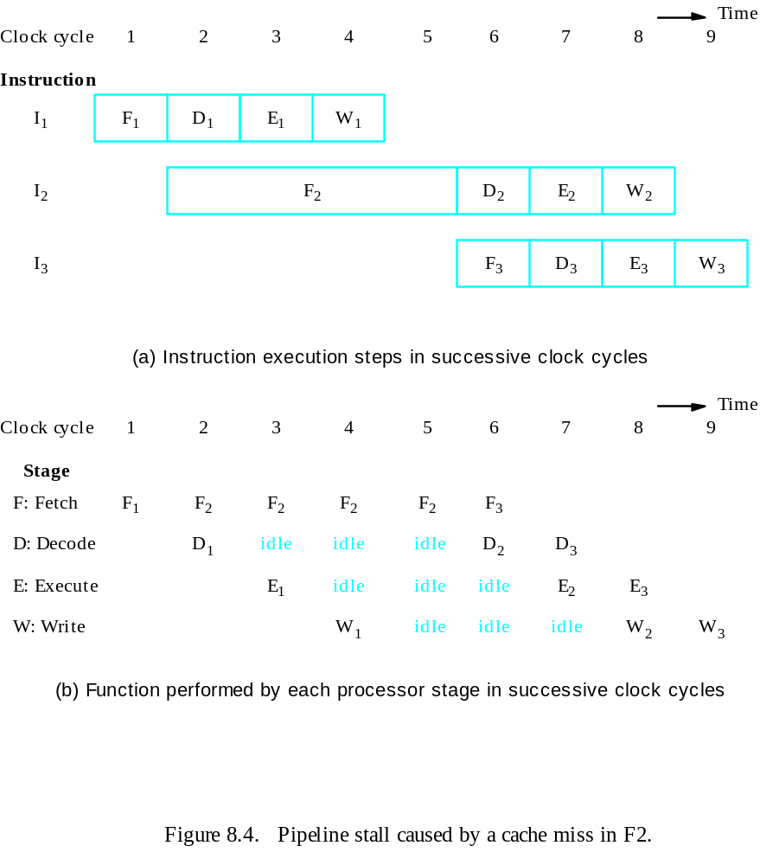
Pipeline Performance
Instruction hazard
Idle periods – stalls (bubbles)

Slide 15
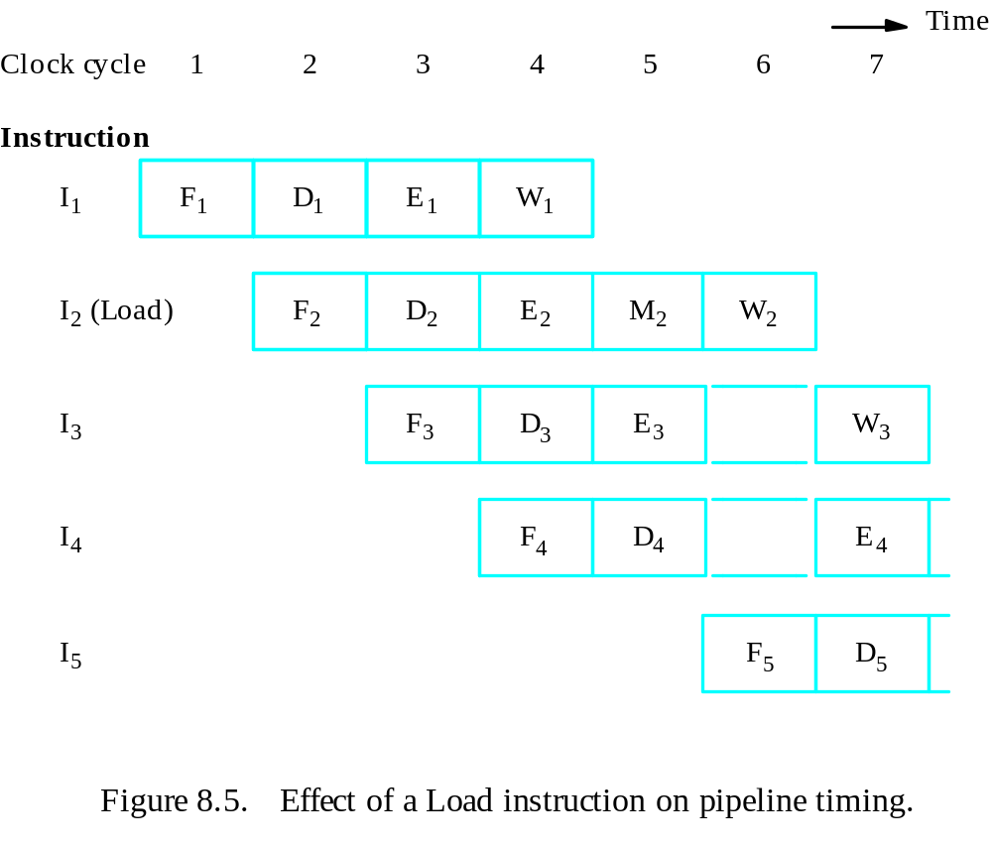
Pipeline Performance
Structural hazard
Load X(R1), R2

Slide 16
Pipeline Performance
Again, pipelining does not result in individual instructions being executed faster; rather, it is the throughput that increases.
Throughput is measured by the rate at which instruction execution is completed.
Pipeline stall causes degradation in pipeline performance.
We need to identify all hazards that may cause the pipeline to stall and to find ways to minimize their impact.

Slide 17
Quiz
Four instructions, the I2 takes two clock cycles for execution. Pls draw the figure for 4-stage pipeline, and figure out the total cycles needed for the four instructions to complete.

